Slide 1
Chapter 1: Modern Network Security Threats
CCNA Security v2.0

Slide 2
Chapter Outline
1.0 Introduction
1.1 Securing Networks
1.2 Network Threats
1.3 Mitigating Threats
1.4 Summary

Slide 3
Section 1.1: Securing Networks
Upon completion of this section, you should be able to:
Describe the current network security landscape.
Explain how all types of networks need to be protected.

Slide 4
Topic 1.1.1: Current State of Affairs

Slide 5
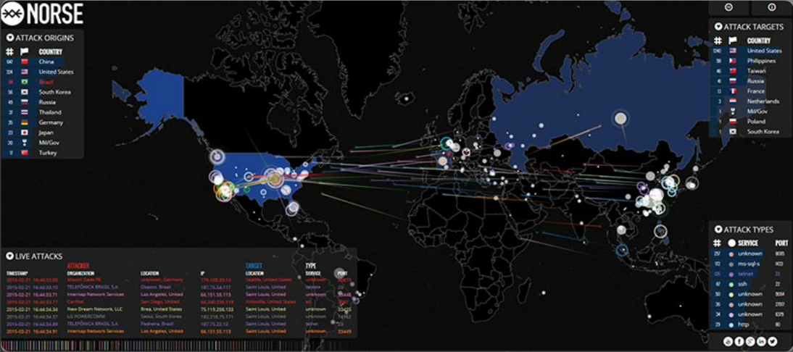
Networks Are Targets
Notes:
1.1.1.1 Networks Are Targets
http://map.ipviking.com/

Slide 6
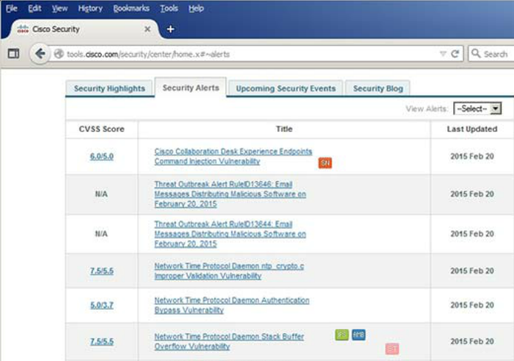
Drivers for Network Security
Common network security terms:
Threat
Vulnerability
Mitigation
Risk
Cisco Security Intelligence Operations
Notes:
1.1.1.2 Drivers for Network Security

Slide 7
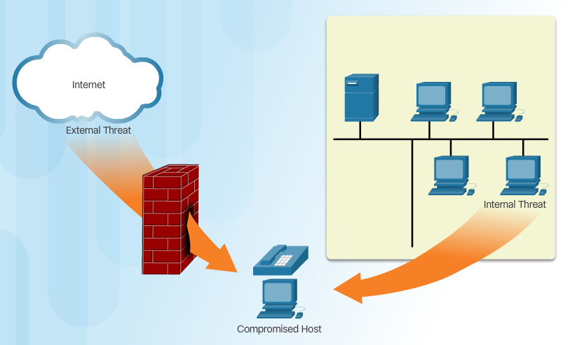
Vectors of Network Attacks
Notes:
1.1.1.3 Vectors of Network Attacks

Slide 8
Data Loss
Vectors of data loss:
Email/Webmail
Unencrypted Devices
Cloud Storage Devices
Removable Media
Hard Copy
Improper Access Control
Notes:
1.1.1.4 Data Loss

Slide 9
Topic 1.1.2: Network Topology Overview

Slide 10
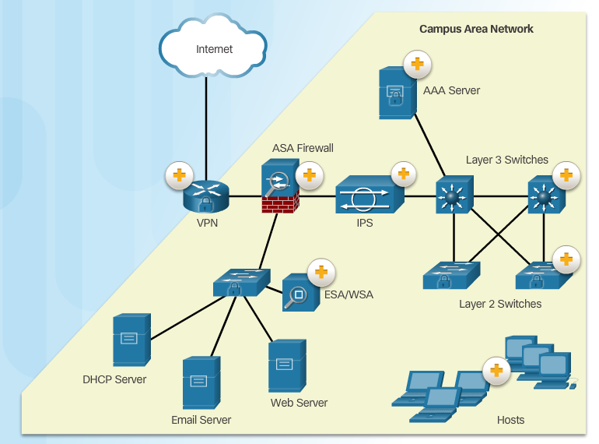
Campus Area Networks
Notes:
1.1.2.1 Campus Area Networks

Slide 11
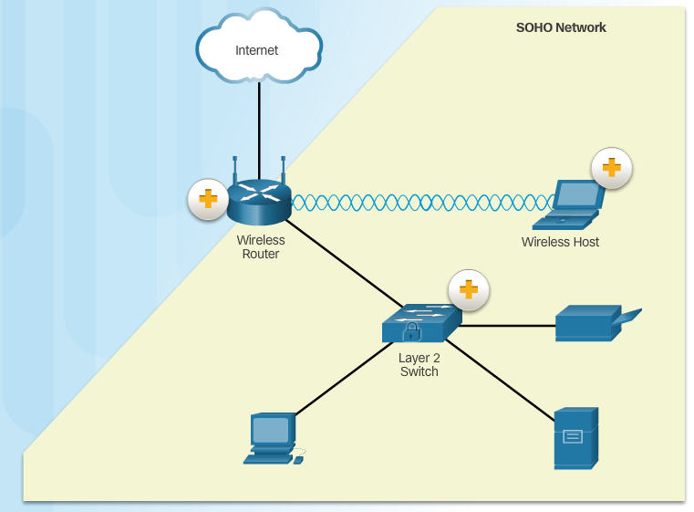
Small Office and Home Office Networks
Notes:
1.1.2.2 Small Office and Home Office Networks

Slide 12
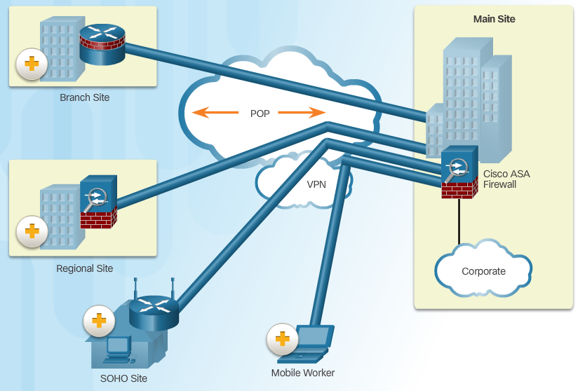
Wide Area Networks
Notes:
1.1.2.3 Wide Area Networks

Slide 13
Data Center Networks
Outside perimeter security:
On-premise security officers
Fences and gates
Continuous video surveillance
Security breach alarms
Inside perimeter security:
Electronic motion detectors
Security traps
Continuous video surveillance
Biometric access and exit sensors
Notes:
1.1.2.4 Data Center Networks

Slide 14
Cloud and Virtual Networks
VM-specific threats:
Hyperjacking
Instant On activation
Antivirus storm
Components of a secure data center:
Secure segmentation
Threat defense
Visibility
The Evolving Network Border
Critical MDM functions for BYOD network:
Data encryption
PIN enforcement
Data wipe
Data loss prevention
Jailbreak/root detection
Notes:
1.1.2.5 Cloud and Virtual Networks
1.1.2.6 The Evolving Network Border
1.1.2.7 Activity - Network Topology Protection Overview

Slide 15
Section 1.2: Network Threats
Upon completion of the section, you should be able to:
Describe the evolution of network security.
Describe the various types of attack tools used by hackers.
Describe malware.
Explain common network attacks.

Slide 16
Topic 1.2.1: Who is Hacking Our Networks?

Slide 17

The Hacker & The Evolution of Hackers
Modern hacking titles:
Script Kiddies
Vulnerability Brokers
Hacktivists
Cyber Criminals
State-Sponsored Hackers
Notes:
1.2.1.1 The Hacker
1.2.1.2 The Evolution of Hackers
1.2.1.3 Cyber Criminals
1.2.1.4 Hacktivists
1.2.1.5 State-Sponsored Hackers

Slide 18
Topic 1.2.2: Hacker Tools

Slide 19
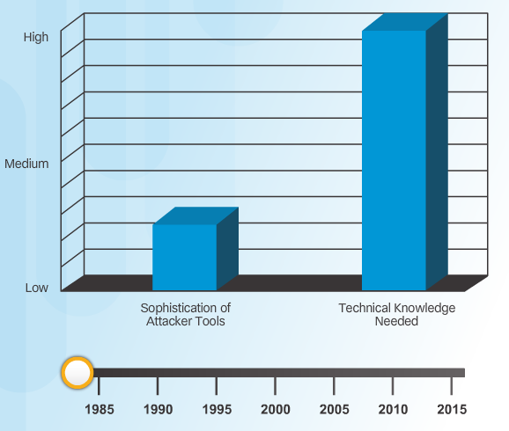
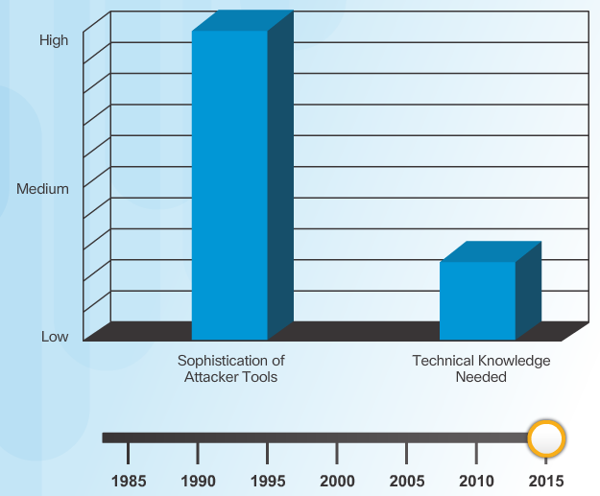
Introduction of Attack Tools
Notes:
1.2.2.1 Introduction of Attack Tools

Slide 20
Evolution of Security Tools
Penetration testing tools:
Password crackers
Wireless hacking
Network scanning and hacking
Packet crafting
Packet sniffers
Rootkit detectors
Fuzzers to search vulnerabilities
Forensic
Debuggers
Hacking operating systems
Encryption
Vulnerability exploitation
Vulnerability Scanners
Notes:
1.2.2.2 Evolution of Security Tools

Slide 21
Categories of Attack Tools
Network hacking attacks:
Eavesdropping
Data modification
IP address spoofing
Password-based
Denial-of-service
Man-in-the-middle
Compromised-key
Sniffer
Notes:
1.2.2.3 Categories of Attack Tools

Slide 22
Topic 1.2.3: Malware

Slide 23
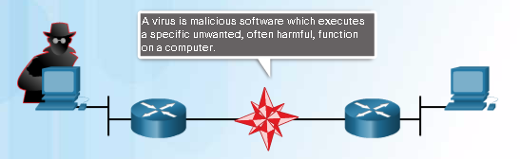
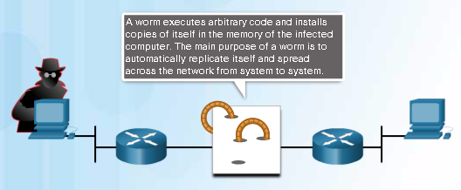
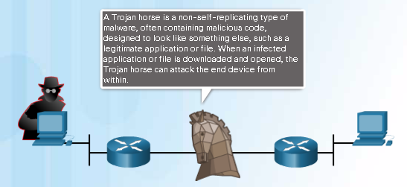
Various Types of Malware
Notes:
1.2.3.1 Various Types of Malware

Slide 24

Viruses
Notes:
1.2.3.2 Viruses

Slide 25
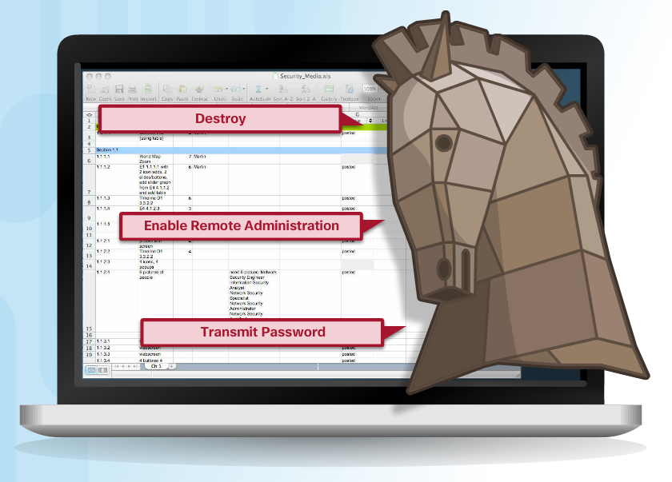
Trojan Horse Classification
Classifications:
Security software disabler
Remote-access
Data-sending
Destructive
Proxy
FTP
DoS
Notes:
1.2.3.3 Trojan Horses
1.2.3.4 Trojan Horse Classification

Slide 26
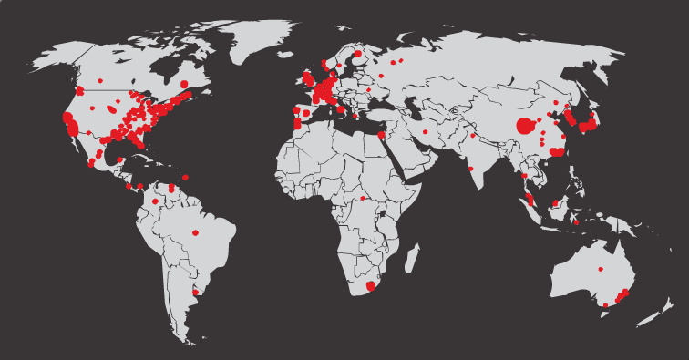
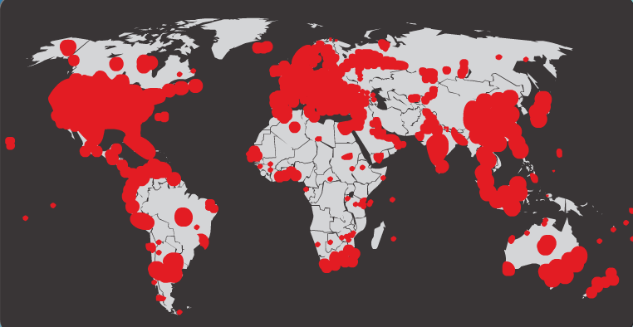
Worms
Initial Code Red Worm Infection
Code Red Worm Infection 19 Hours Later
Notes:
1.2.3.5 Worms

Slide 27
Worm Components
Code Red Worm Propagation
1. Propagate for 19 days
2. Launch DoS attack for next 7 days
3. Stop and go dormant for a few days
4. Repeat the cycle
Components:
Enabling vulnerability
Propagation mechanism
Payload
Notes:
1.2.3.6 Worm Components

Slide 28

Other Malware
Ransomware
Spyware
Adware
Scareware
Phishing
Rootkits
Notes:
1.2.3.7 Other Malware
1.2.3.8 Activity - Identify the Malware Type

Slide 29
Topic 1.2.4: Common Network Attacks

Slide 30
Types of Network Attacks
Data Modification
Syn Flood
Smurf Attack
Reconnaissance Access DoS
Notes:
1.1.1.1 Networks Are Targets

Slide 31

Reconnaissance Attacks
Initial query of a target
Ping sweep of the target network
Port scan of active IP addresses
Vulnerability scanners
Exploitation tools
Notes:
1.2.4.2 Reconnaissance Attacks
1.2.4.3 Sample Reconnaissance Attacks

Slide 32
Access Attacks
A few reasons why hackers use access attacks:
To retrieve data
To gain access
To escalate access privileges
A few types of access attacks include:
Password
Trust exploitation
Port redirection
Man-in-the-middle
Buffer overflow
IP, MAC, DHCP spoofing
Notes:
1.2.4.5 Access Attacks
1.2.4.6 Types of Access Attacks

Slide 33
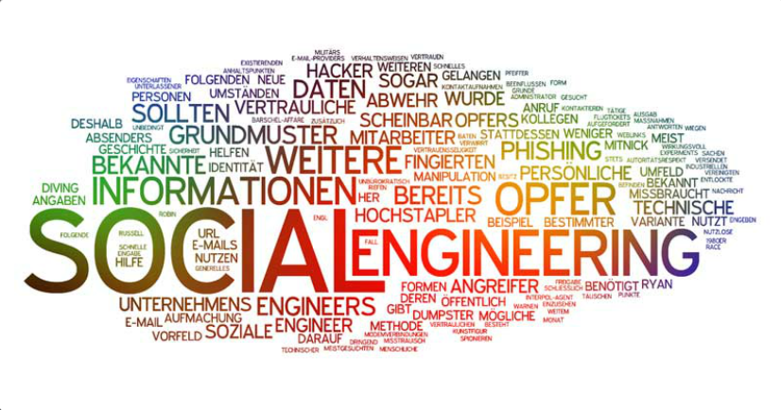
Social Engineering Attacks
Pretexting
Phishing
Spearphishing
Spam
Tailgating
Something for Something
Baiting
Notes:
1.2.4.6 Social Engineering

Slide 34
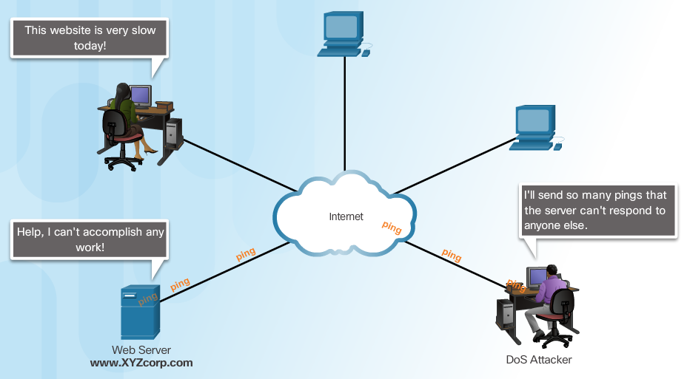
Denial of Service Attacks
Notes:
1.2.4.7 Denial of Service Attacks
1.2.4.8 Types of DoS Attacks

Slide 35
DDoS Attacks
Hacker builds a network of infected machines
A network of infected hosts is called a botnet.
The compromised computers are called zombies.
Zombies are controlled by handler systems.
Zombie computers continue to scan and infect more targets
Hacker instructs handler system to make the botnet of zombies carry out the DDoS attack
Notes:
1.2.4.9 DDoS Attacks
1.2.4.10 DDoS Attacks (cont.) - Video https://www.youtube.com/watch?v=NogCN78XN2w
1.2.4.11 Activity - Identify the Types of Attack
1.2.4.12 Lab - Social Engineering

Slide 36
Section 1.3 Mitigating Threats
Upon completion of this section, you should be able to::
Describe methods and resources to protect the networks.
Describe a collection of domains for network security.
Explain the purpose of the Cisco SecureX Architecture.
Describe the techniques used to mitigate common network attacks.
Explain how to secure the three functional areas of Cisco routers and switches.

Slide 37
Topic 1.3.1: Defending the Network

Slide 38

Network Security Professionals
Notes:
1.3.1.1 Network Security Professionals

Slide 39
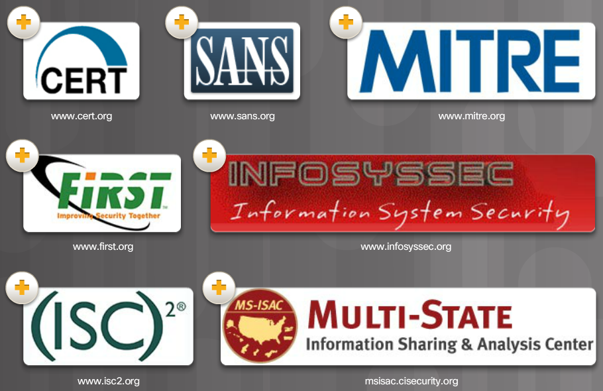
Network Security Organizations
Notes:
1.3.1.2 Network Security Organizations

Slide 40
Confidentiality, Integrity, Availability
Components of Cryptography
Confidentiality: Uses encryption to encrypt and hide data.
Integrity: Uses hashing algorithms to ensure data is unaltered during operation.
Availability: Assures data is accessible. Guaranteed by network hardening mechanisms and backup systems.
Notes:
1.3.1.3 Confidentiality, Integrity, Availability

Slide 41
Topic 1.3.2: Domains of Network Security

Slide 42
Network Security Domains
Risk assessment
Security policy
Organization of information security
Asset management
Human resources security
Physical and environmental security
Communications and operations management
Information systems acquisition, development, and maintenance
Access control
Information security incident management
Business continuity management
Compliance
Notes:
1.3.2.1 Network Security Domains

Slide 43
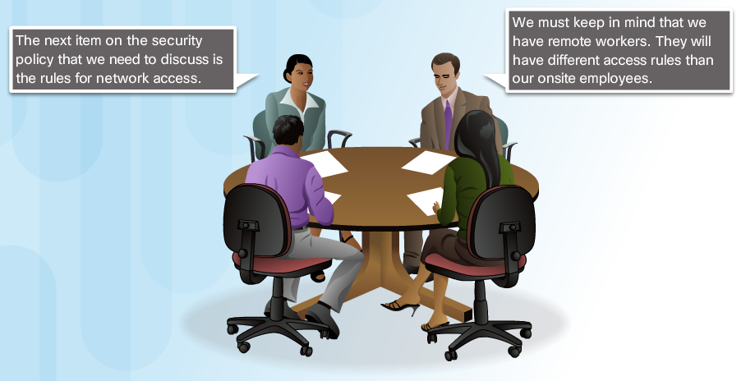
Network Security Policy
Notes:
1.3.2.2 Security Policy
1.3.2.3 Network Security Policy

Slide 44

Network Security Policy Objectives
Notes:
1.3.2.4 Network Security Policy Objectives

Slide 45
Topic 1.3.3: Introducing the Cisco SecureX Architecture

Slide 46
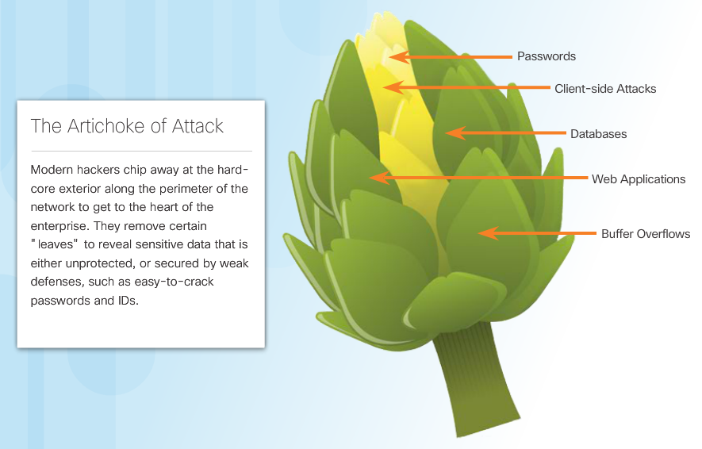
The Security Artichoke
Notes:
1.3.3.1 The Security Artichoke

Slide 47
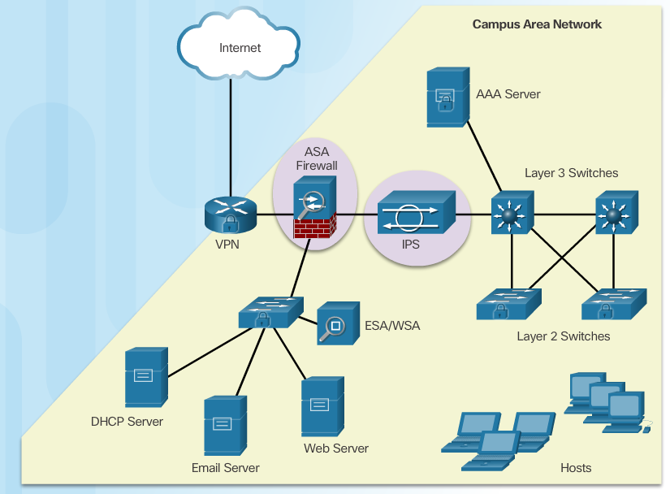
Evolution of Network Security Tools
Notes:
1.3.3.2 Evolution of Network Security Tools

Slide 48
SecureX Product Families
SecureX
Server Edge and Branch
Secure Email and Web
Secure Mobility
Secure Access
Secure Data Center and Virtualization
Notes:
1.3.3.3 SecureX Products

Slide 49
SecureX Security Technology
Cisco SecureX Architecture:
Scanning engines
Delivery mechanisms
Security intelligence operations (SIO)
Policy management consoles
Next-generation endpoint
Notes:
1.3.3.4 SecureX Security Technology

Slide 50

Centralized Context-Aware Network Scanning Element
Defines security policies based on five parameters:
Type of device being used for access
Person’s identity
Application in use
Location
Time of access
Notes:
1.3.3.5 Centralized Context-Aware Network Scanning Element

Slide 51
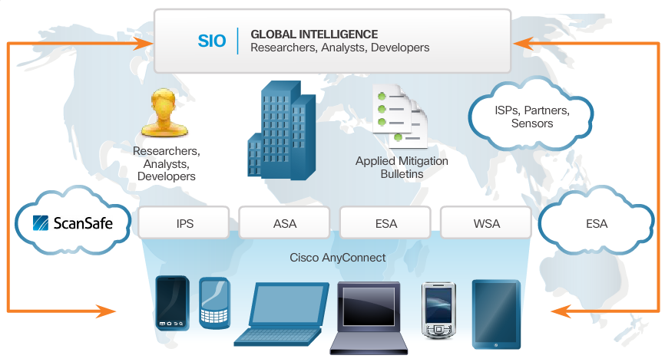
Cisco Security Intelligence Operations
Notes:
1.3.3.6 Cisco Security Intelligence Operations

Slide 52
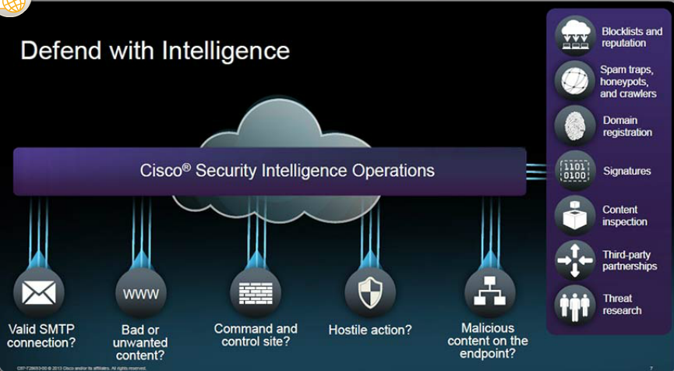
Cisco Security Intelligence Operations (cont.)
Notes:
1.3.3.6 Cisco Security Intelligence Operations

Slide 53
Topic 1.3.4: Mitigating Common Network Threats

Slide 54
Defending the Network
Best practices:
Develop a written security policy.
Educate employees about the risks of social engineering, and develop strategies to validate identities over the phone, via email, or in person.
Control physical access to systems.
Use strong passwords and change them often.
Encrypt and password-protect sensitive data.
Implement security hardware and software.
Perform backups and test the backed up files on a regular basis.
Shut down unnecessary services and ports.
Keep patches up-to-date by installing them weekly or daily to prevent buffer overflow and privilege escalation attacks.
Perform security audits to test the network.
Notes:
1.3.4.1 Defending the Network

Slide 55
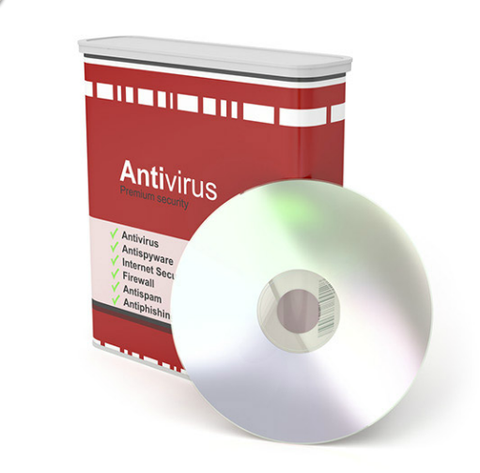
Mitigating Malware
Notes:
1.3.4.2 Mitigating Malware

Slide 56
Mitigating Worms
Containment
Inoculation
Quarantine
Treatment
Notes:
1.3.4.3 Mitigating Worms

Slide 57
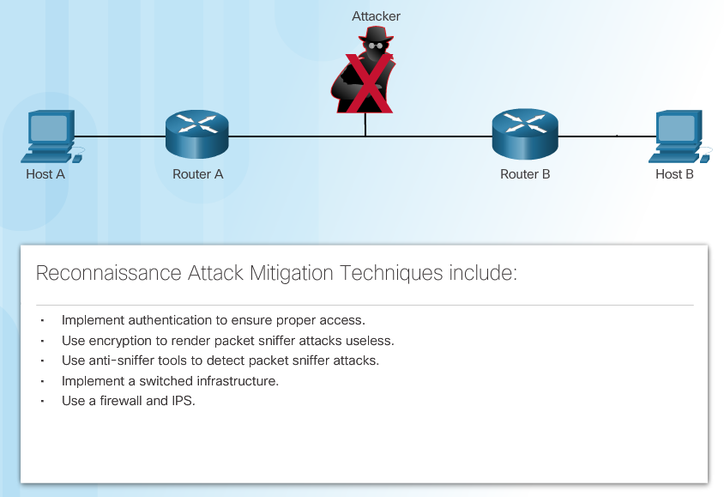
Mitigating Reconnaissance Attacks
Notes:
1.3.4.4 Mitigating Reconnaissance Attacks

Slide 58
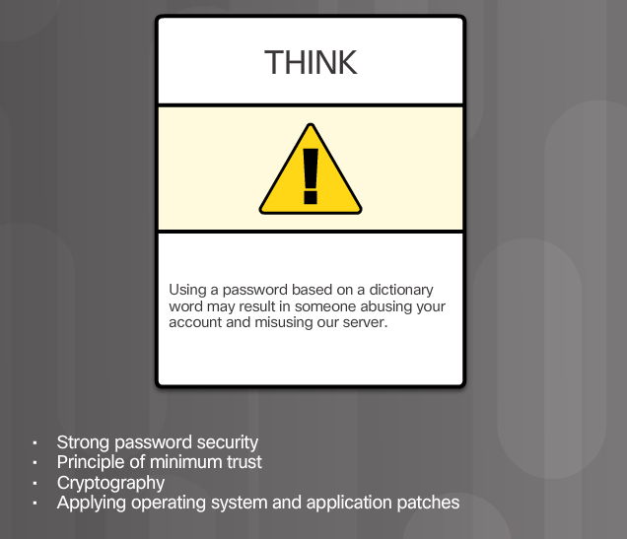
Mitigating Access Attacks
Notes:
1.3.4.5 Mitigating Access Attacks

Slide 59
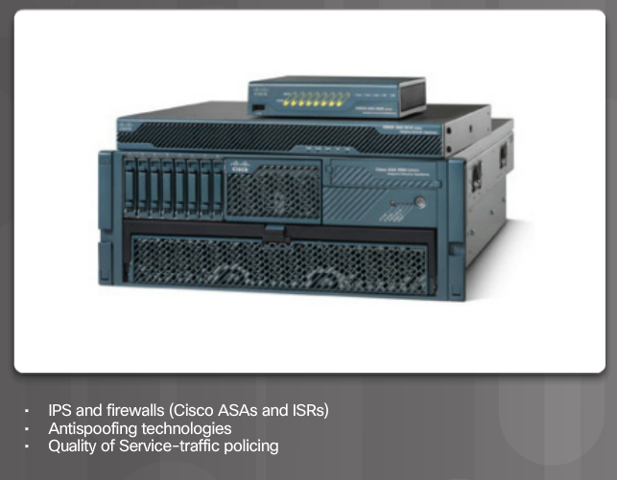
Mitigating DoS Attacks
Notes:
1.3.4.6 Mitigating DoS Attacks

Slide 60
Topic 1.3.5: Cisco Network Foundation Protection Framework

Slide 61
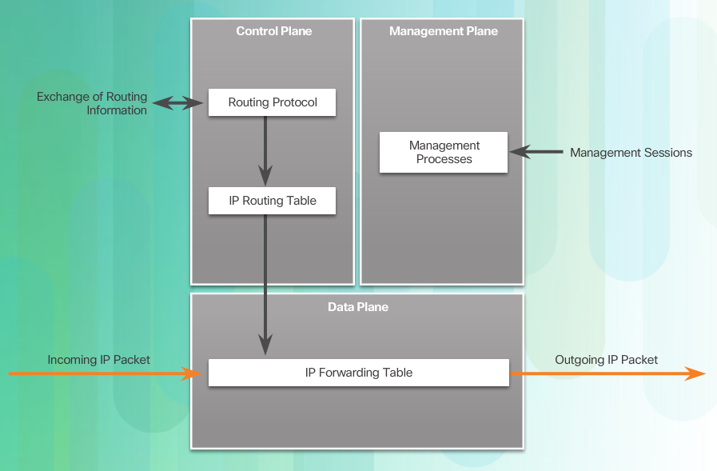
NFP Framework
Notes:
1.3.5.1 NFP Framework

Slide 62
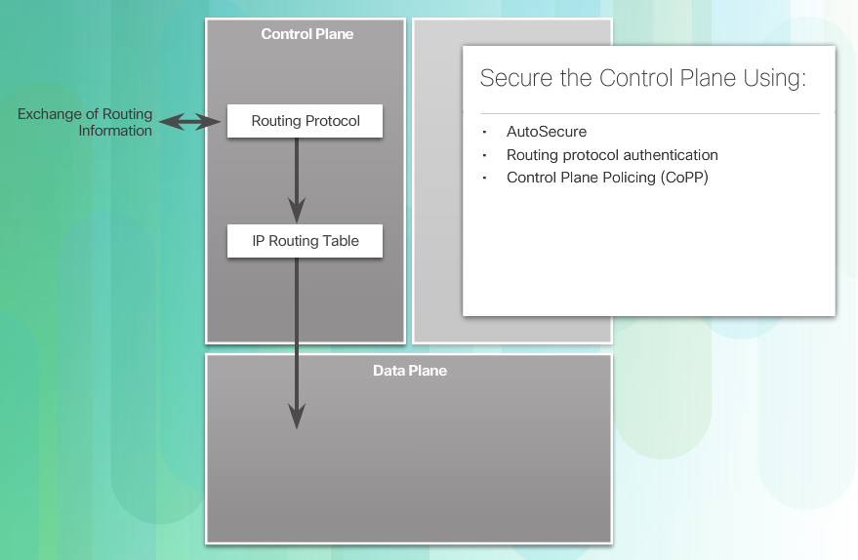
Securing the Control Plane
Notes:
1.3.5.2 Securing the Control Plane

Slide 63
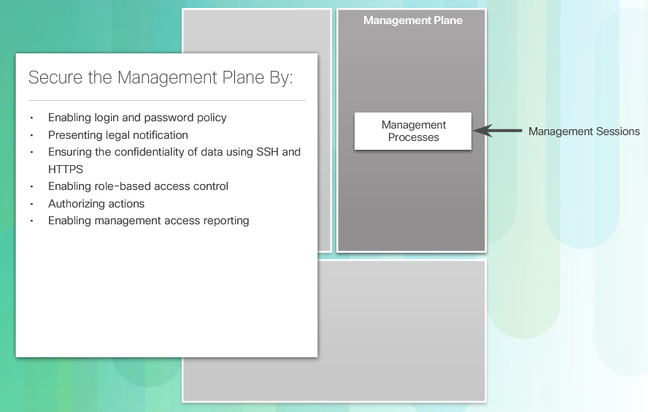
Securing the Management Plane
Notes:
1.3.5.3 Securing the Management Plane

Slide 64
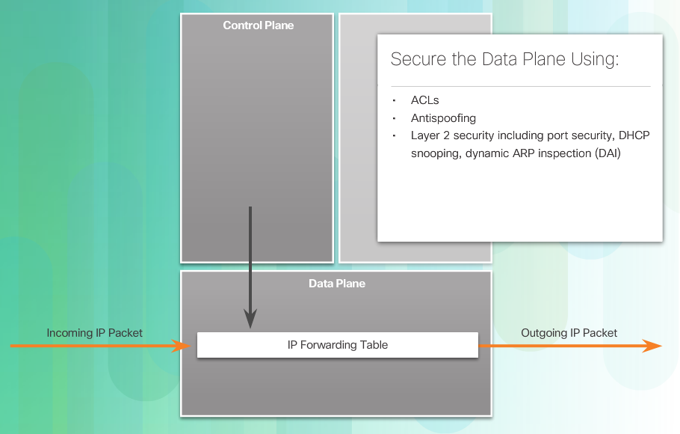
Securing the Data Plane
Notes:
1.3.5.4 Securing the Data Plane
1.3.5.5 Activity - Identify Characteristics of the NFP Framework

Slide 65
Section 1.4: Summary
Chapter Objectives:
Explain network security.
Describe various types of threats and attacks.
Explain tools and procedures to mitigate the effects of malware and common network attacks.
Notes:
1.4.1.1 Lab - Researching Network Attacks and Security Audit Tools
1.4.1.2 Summary

Slide 67
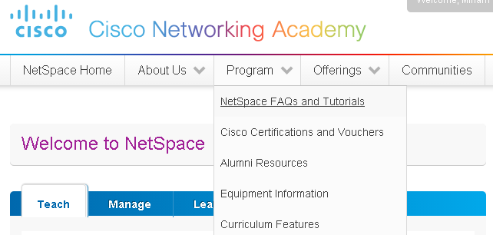
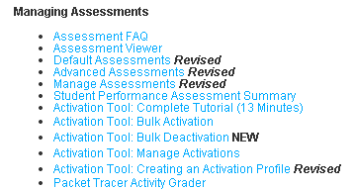
Instructor Resources
Remember, there are helpful tutorials and user guides available via your NetSpace home page. (https://www.netacad.com)
These resources cover a variety of topics including navigation, assessments, and assignments.
A screenshot has been provided here highlighting the tutorials related to activating exams, managing assessments, and creating quizzes.
1
2
Notes:
https://www.netacad.com

